Slide 1
EXTREME SPORTS!

Slide 2
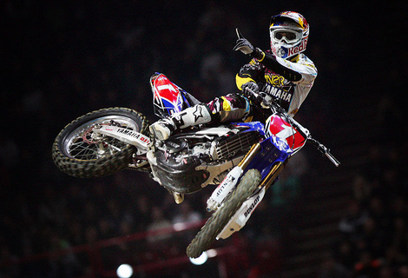
Motocross

Slide 3
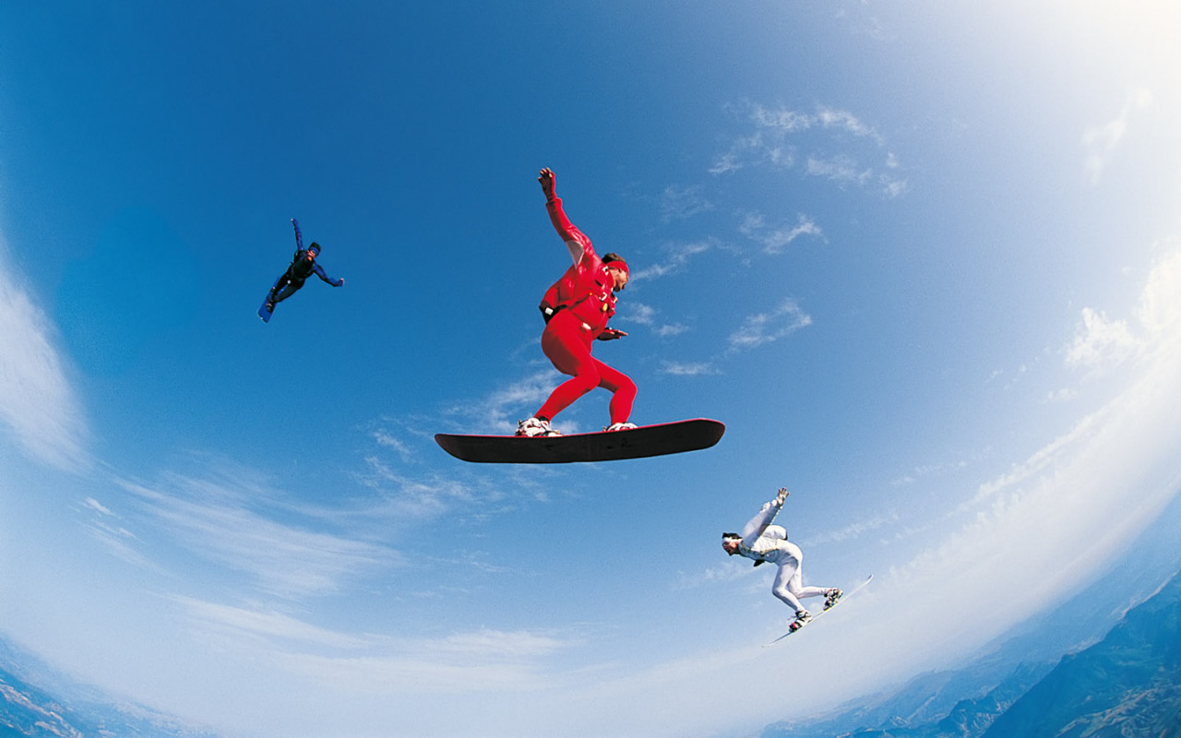
Sky Surfing

Slide 4
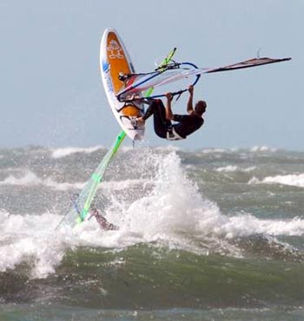
Wind Surfing

Slide 5
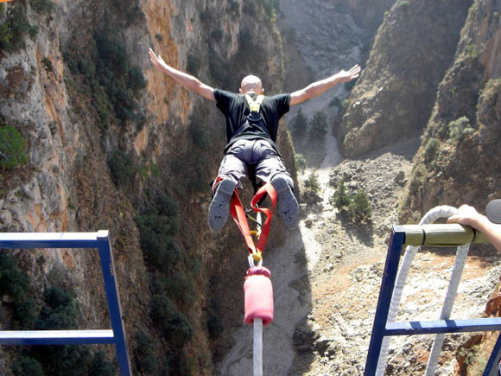
Bungee Jumping

Slide 6
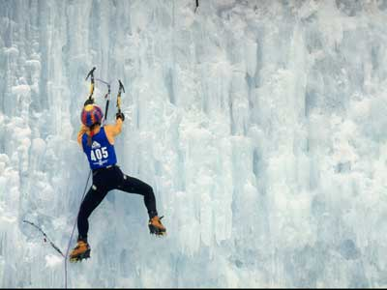
Ice Climbing

Slide 7
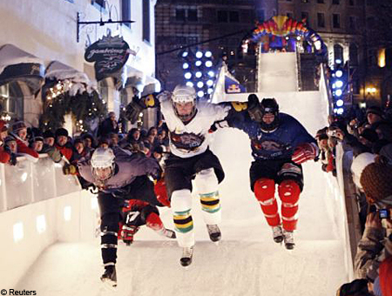
Crashed Ice

Slide 8
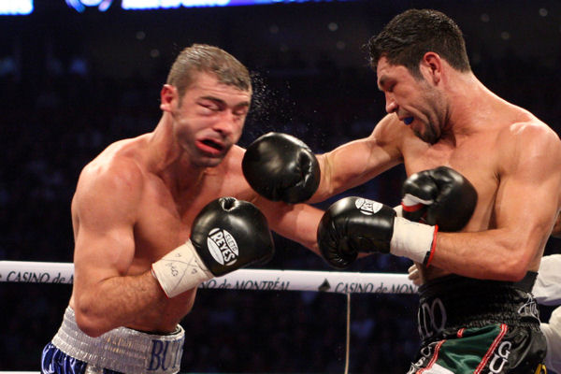
Boxe

Slide 9
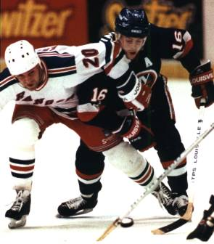
Hockey?

Slide 10
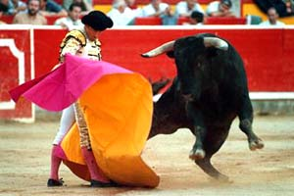
Bullfighting

Slide 11
Hockey Fighting

Slide 12
Would hockey be as popular without fighting?
Why are people interested in hockey fights?
Would hockey be as popular without violence?

Slide 13
Would you let your child watch hockey on TV?
Do you think hockey fighting encourages violence in our society? In our schools?
Do you think hockey fighting on TV trivializes fighting in general?

Slide 14
Topics
For or against bullfighting
For or against hockey fighting

Slide 15
Instructions
100 words (+/- 10%)
Introduction with a thesis statement
(for or against)
2 arguments to support your position ( with explanations)
Conclusion

Slide 16
Grading
Content ( /10)
2 pts – Intro and thesis statement
3 pts – First argument and explanations
3 pts – Second argument and explanations
2 pts – Conclusion
Language ( /10)

