Slide 1
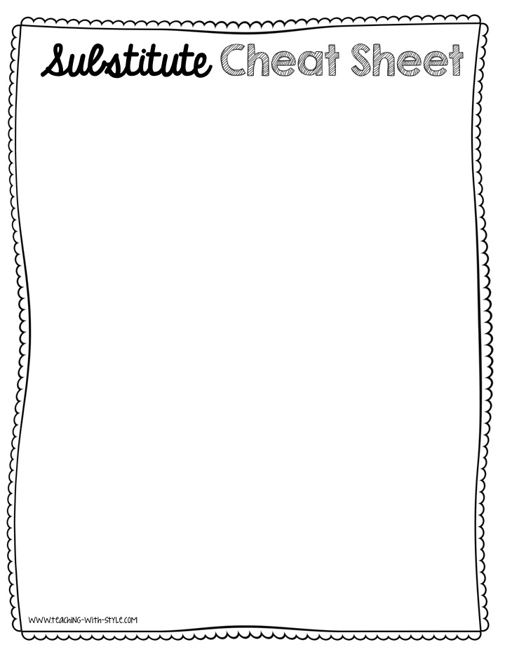
Attention Signal
Whole Class Management
Individual Management
Class Jobs
Class Rules
Bathroom/Drink Procedures
Pencil Procedures

